Slide 1
PROJECT TITLE: Sentiment Analysis of Social Media Presence
PIP104 University Project-II
Review-2
Batch Number: CBD-G 2
Student Name | Roll Number
Saikumar B Ganesh K Srinivas P Sai Pallavi Y | 20211CBD0009 20211CBD0005 20211CBD0019 20211CBD0055
Under the Supervision of,
Dr. M Swapna
Associate Professor
School of Computer Science and Engineering
Presidency University

Slide 2
Content
Introduction
Literature Review
Objectives
Methodology
Timeline of the project
Expected Outcomes
Conclusion
Future Work

Slide 3
Introduction
Problem Description:
This project focuses on developing a sentiment analysis solution for social media presence.
Sentiment analysis determines the emotional tone conveyed in text or speech.
It helps analyze public perception, customer feedback, and brand reputation.
By studying sentiment trends, organizations can identify issues and take corrective actions.
The project aims to classify Amazon product reviews as positive or negative using Machine Learning models.

Slide 4
Literature Review
1. Fuzzy Rule-based Unsupervised Sentiment Analysis from Social Media Posts
Uses a fuzzy logic-based unsupervised approach with multiple lexicons for sentiment classification.
Struggles with short text sentiment detection, sarcasm, and multilingual analysis.
Can be improved using deep learning models like LSTM, BERT, and hybrid lexicon-ML approaches.

Slide 5
Literature Review
2. Sentiment Analysis in Social Media and Its Application
Provides a systematic review of lexicon-based and opinion mining methods in sentiment analysis.
Highlights key challenges like contextual ambiguity, sarcasm detection, and real-time adaptability.
Suggests solutions such as transformer models (BERT, GPT) and hybrid classification methods.

Slide 6
Literature Review
3. Artificial Intelligence for Social Media Safety and Security
Uses machine learning and deep learning for automated threat detection in social media.
Faces challenges related to AI bias, ethical concerns, and privacy in content moderation.
Recommends integrating Explainable AI (XAI) and unbiased dataset selection to improve fairness.

Slide 7
Literature Review
4. Impact of Social Media in Security and Crisis Management
Explores the role of sentiment analysis in crisis management by monitoring public reactions.
Identifies challenges like misinformation, fake news, and real-time data processing.
Suggests solutions such as fact-checking algorithms, real-time NLP, and geospatial sentiment analysis.

Slide 8
Literature Review
5. A Review on Sentiment Analysis from Social Media Platforms
Discusses different sentiment analysis techniques and their application domains.
Identifies challenges such as class imbalance, multilingual complexity, and feature extraction.
Recommends enhanced deep learning techniques, data augmentation, and advanced feature engineering.

Slide 9
Objectives
Develop a Robust Sentiment Analysis Model
Handle Language and Contextual Challenges
Provide Visualization and Reporting Tools
Perform Real-Time Sentiment Tracking

Slide 10
Methodology
Technology Stack Components:
Language
Python(for its strong NLP libraries and machine learning support)
Machine Learning Algorithms
Random Forest Classification
Decision Tree Classifier
XGBoost
K-Fold Cross-Validation

Slide 11
Continue…
Libraries
Pandas
NumPy
Matplotlib
NLTK
Dataset
Kaggle
Tools
Jupyter Notebook

Slide 12
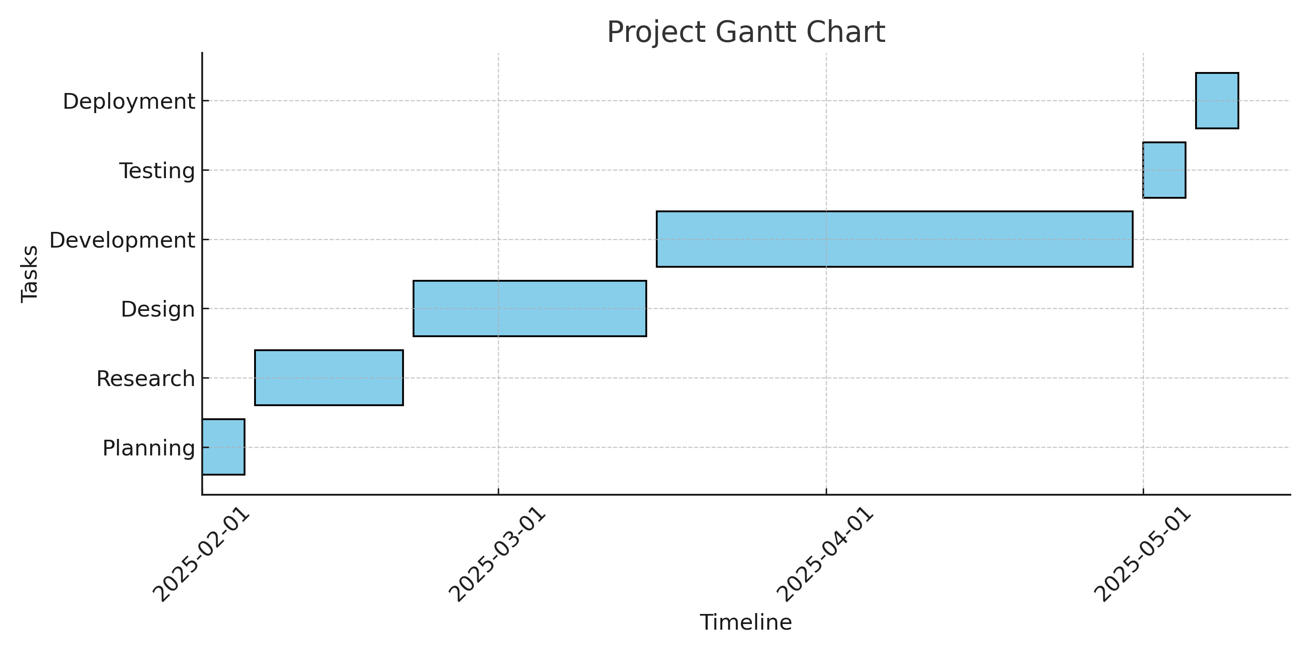
Timeline of Project

Slide 13
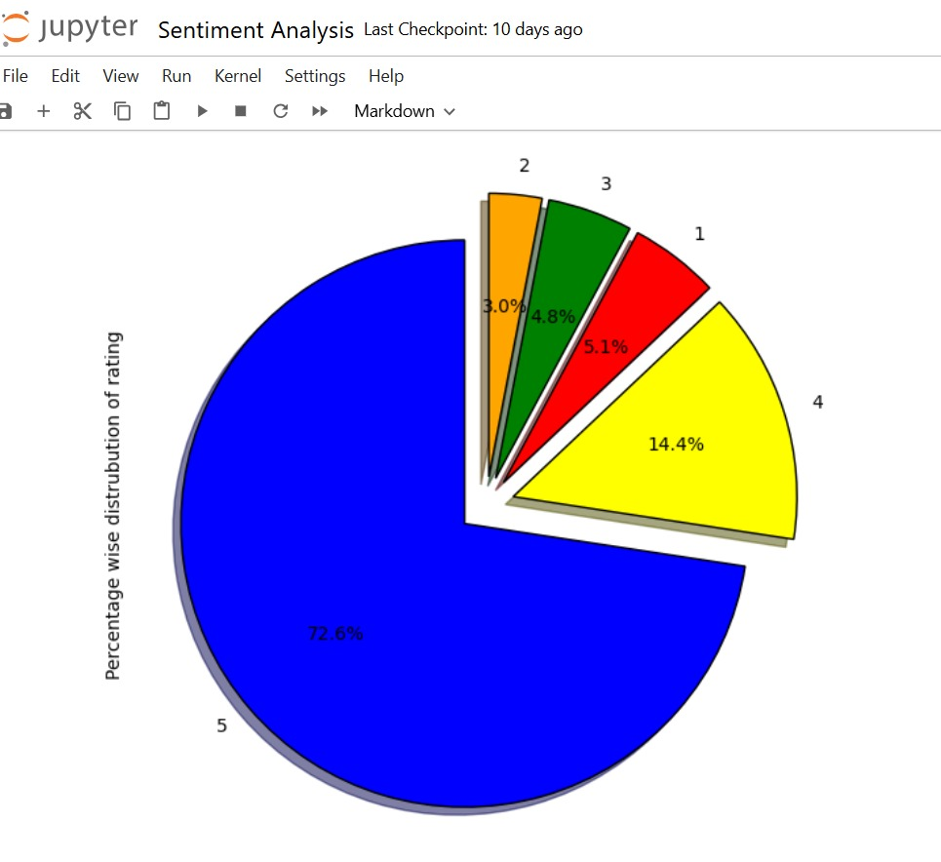
Results

Slide 14
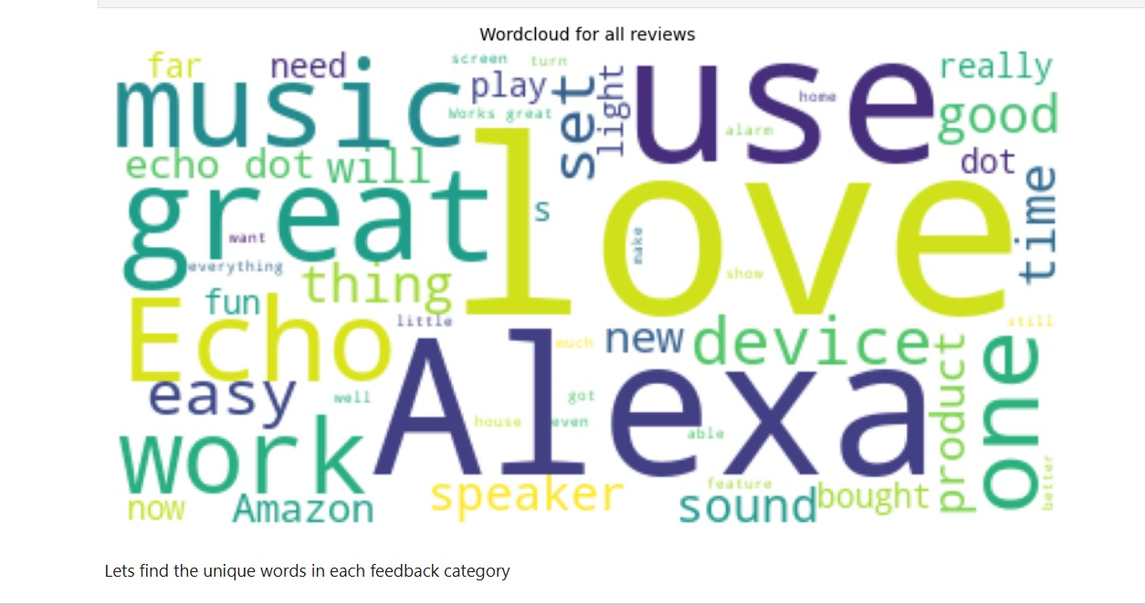
Figure: Word Cloud for All Reviews

Slide 15
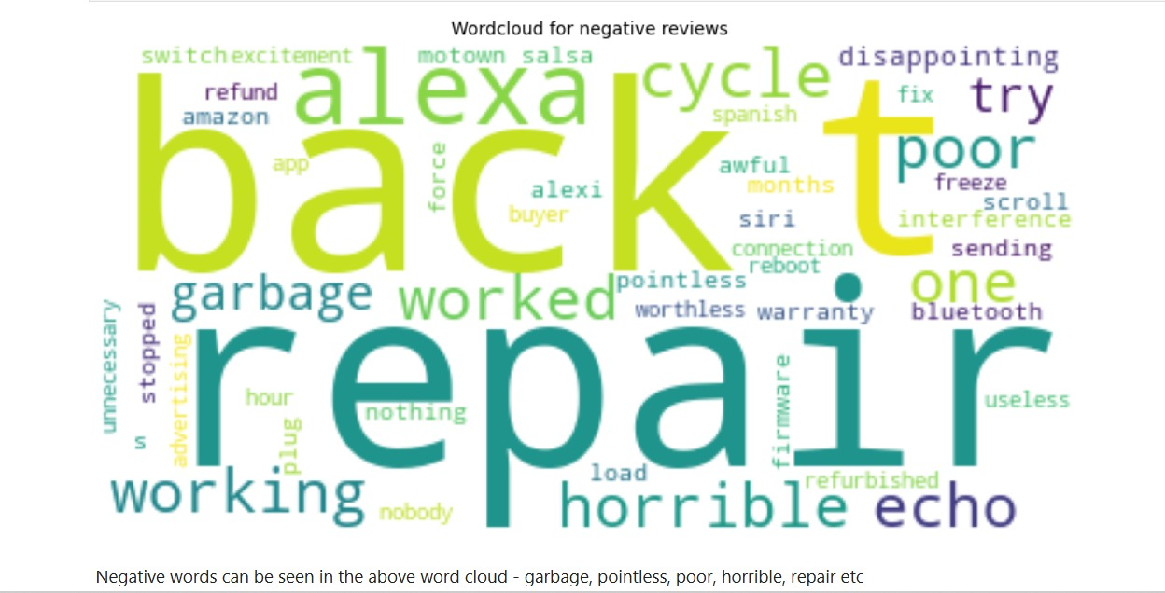
Figure: Word Cloud for Negative Reviews

Slide 16
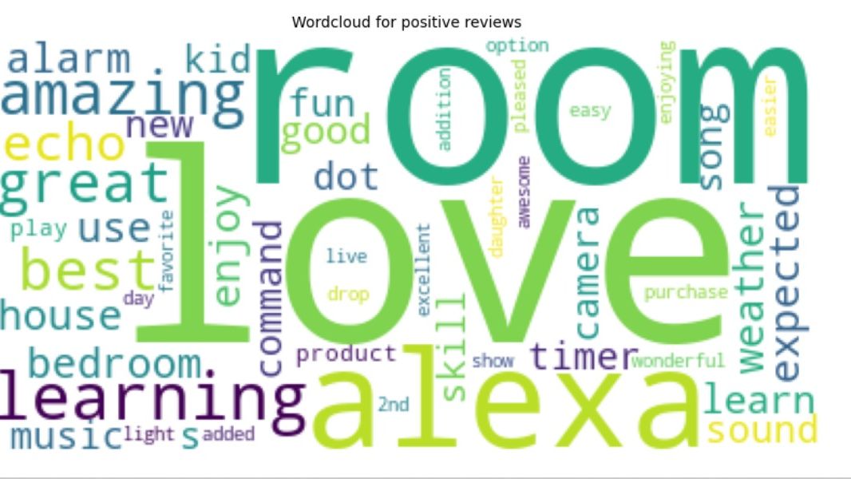
Figure: Word Cloud for Positive Reviews

Slide 17
Expected Outcomes
Accurate Sentiment Classification – Improved sentiment analysis accuracy using machine learning models (Random Forest, Logistic Regression) with optimized feature extraction techniques.
Real-Time Sentiment Monitoring – Integration with Twitter API for live tracking of sentiment trends and analysis of social media data in real time.
Enhanced Context & Multilingual Processing – Better handling of sarcasm, contextual ambiguity, and multilingual text through advanced NLP techniques.
User-Friendly Visualization & Reporting – A web-based interface providing graphical insights, sentiment trends, and interactive reports for better decision-making.

Slide 18
Conclusion
This study presents a sentiment analysis system leveraging machine learning and NLP techniques to classify social media text accurately.
By integrating deep learning models and hybrid approaches, sentiment classification accuracy can be further improved.
The proposed system offers visualization, enhanced contextual understanding for better decision-making. Future work will focus on optimizing AI fairness, explainability, and scalability for broader applications.

Slide 19
Future Work
For Upcoming review…
Creating a website using Flask app
Integrating Machine learning model to Flask app.

Slide 20

Thank You

